Slide 1
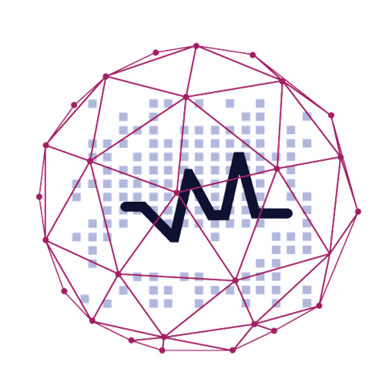
3 Scenarios where Predictive Analytics is a must!

Slide 2
Agenda
At the end of the session, you will be able to :
Types of Analytics
Why Predictive Analytics?
Domains where predictive analysis is creating magic
3 Scenarios where Predictive Analytics is Must
Churn prediction
Sentiment Analysis
Recommendation
Hands on

Slide 3
Types of Analytics?

Slide 4
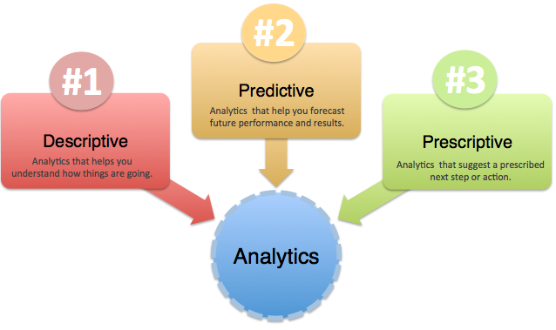
Types of Analytics

Slide 5
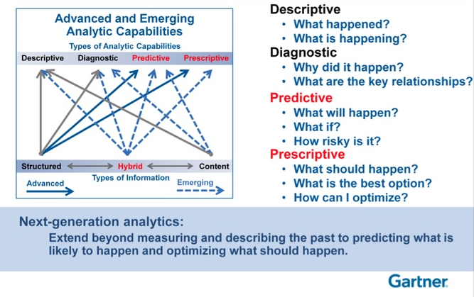
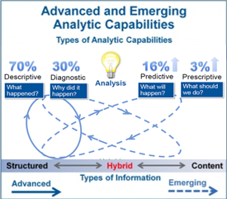
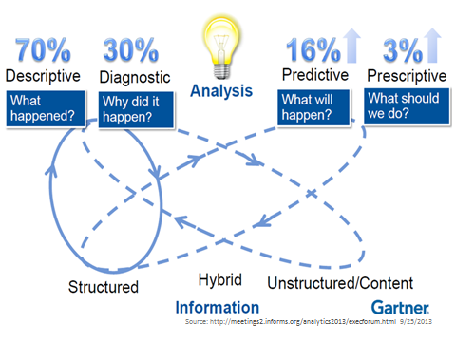
Next-Generation Analytics

Slide 6
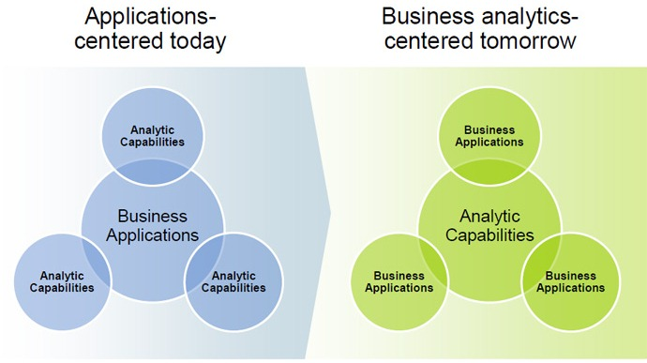
Analytics in Future
Source : gartner

Slide 7
What is Predictive Analytics?

Slide 8
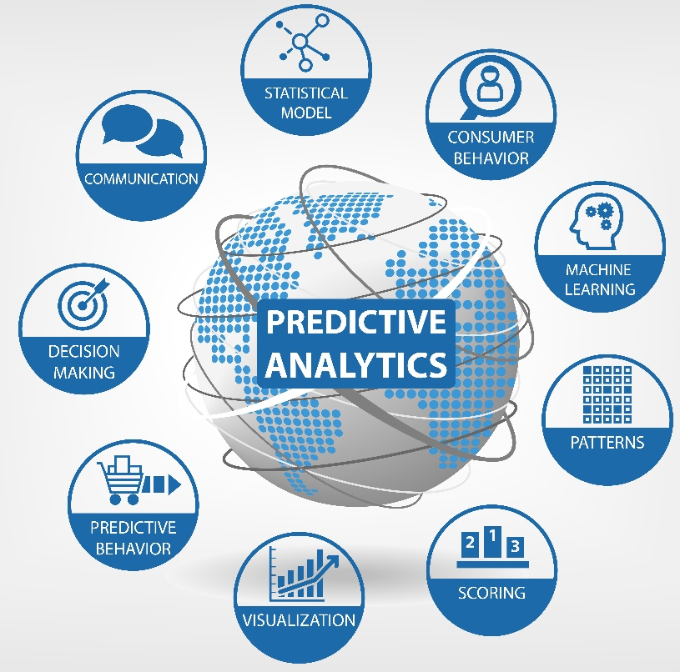
Predictive Analytics
Predictive analytics is the analysis of data by using statistical algorithms and machine-learning techniques to identify the likelihood of future outcomes based on historical data.

Slide 9
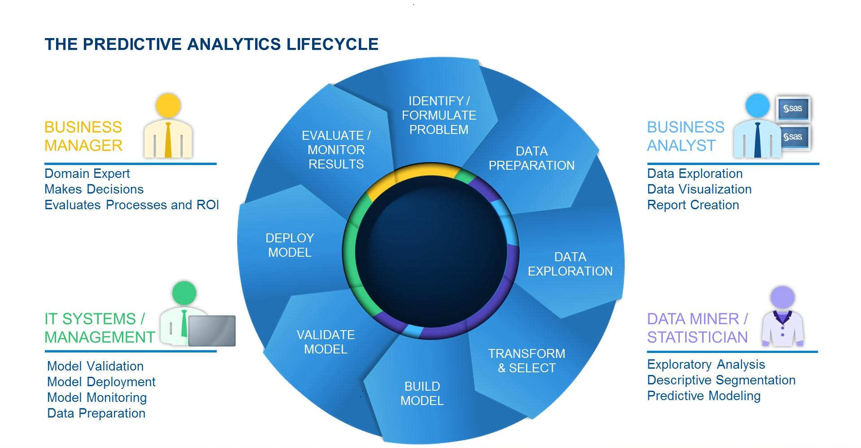
Predictive Analytics Lifecycle
Source: blogs.sas.com

Slide 10
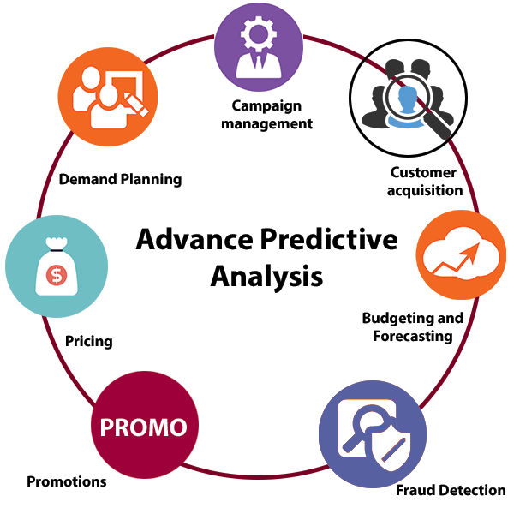
Advantages Predictive Analytics

Slide 11
Why Predictive Analytics?

Slide 12
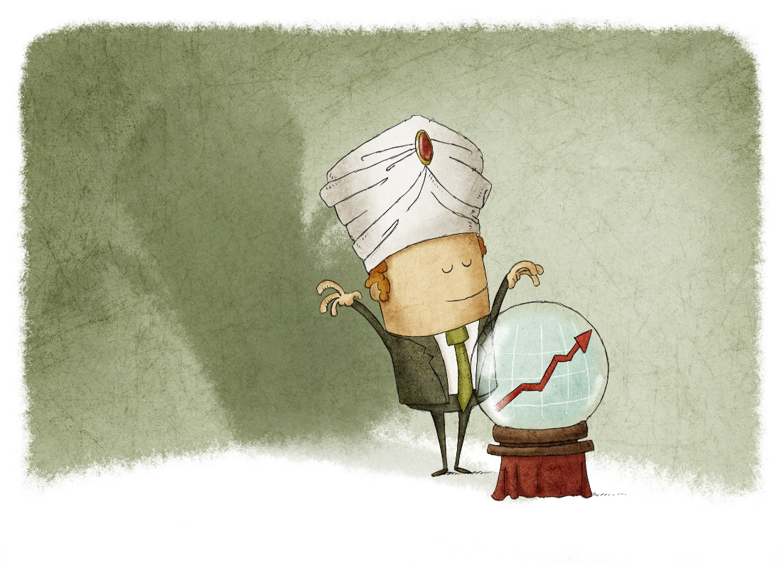
Only Analytics Is Not Enough!
Predictive analytics is a game-changer — it’s like “Moneyball” for… money.

Slide 13
Forbes Says
The top objective for between two-thirds and three-quarters of executives is to develop the ability to model and predict behaviours to the point where individual decisions can be made in real time, based on the analysis at hand.
Source: Forbes

Slide 14



Predictive Analytics Is A Game-Changer
Best Buy determined 7% of its customers were responsible for 43% of its sales. The company then segmented its customers into several archetypes and redesigned stores
Olive Garden uses data to forecast staffing needs and food preparation requirements down to individual menu items and ingredients.
The U.K.’s Royal Shakespeare Co. theatre company then developed a marketing program that increased regular attendees by more than 70% and its membership by 40%
Source: Forbes

Slide 15
Major Domains Using Predictive Analytics
E-commerce
Dating
Banking
Transport
Trading
Retail
IT Industry
Healthcare

Slide 16
3 Scenarios where Predictive Analytics is Must

Slide 17
Churn Prevention and Customer Lifetime Value

Slide 18

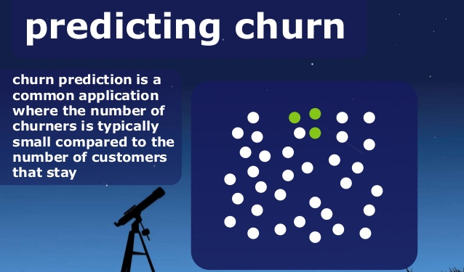
What Is Churn/Attrition ?
When your customers reduce their usage or completely stop using your products or services
They are leaving your brand and might be shopping with your competitor

Slide 19
Reasons For Doing Churn Analysis
1. Reduce marketing costs - maximize profits
2. Reduce churn through predictive models
3. Segment market into alike clusters as per their profits
5. Adversely impacts the profitability of organization
6. Cost of acquiring new customer is much higher than retaining existing customer
7. Reduce the loss of referrals via the existing customers, if they churn out
4. Understand customers & their behaviors
Most important reasons for doing churn analysis:

Slide 20
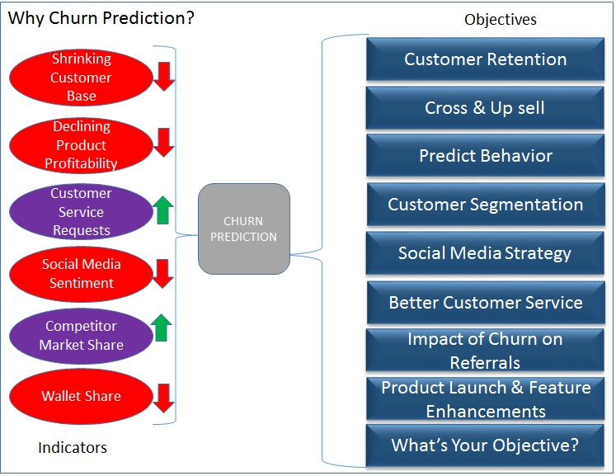
Why Churn Prediction

Slide 21
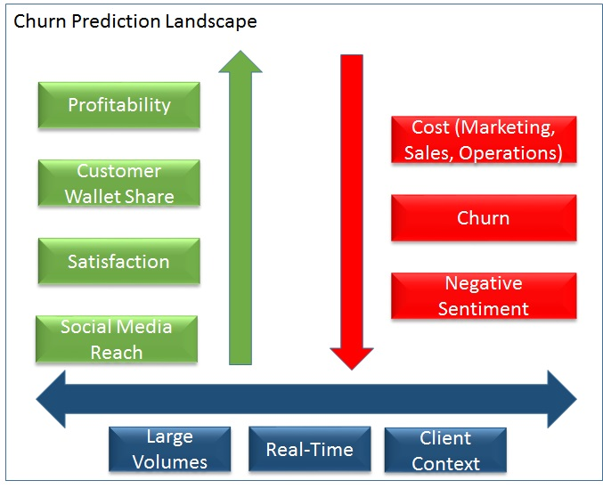
How does it affect business
Cost to acquire a new customer is 5X higher than retaining existing customer
Top 30% of existing customers comprise 100 – 150 % of your profitability
10 – 20 % churn annually
High churn rate will impact growth – Relying on new customers is not a sustainable strategy

Slide 22
What we can do about it
Analyze the following traits :
Action Plan To Combat :
Market Research :
Cost is high
Customer service issue
Competitor has superior service
Segmentation :
Divide you customers in categories
Monitor each segment trend
Predictive modeling :
Which customers are like to churn
Which customers are the most profitable
Proactive marketing and retention strategies:
Use your insights to re-engage your customers
Create separate strategies for each segments
Identify :
Which of customers are churning
Evaluate :
What is the churn rate
Measure:
What is the financial loss
Monitor :
How is it trending

Slide 23
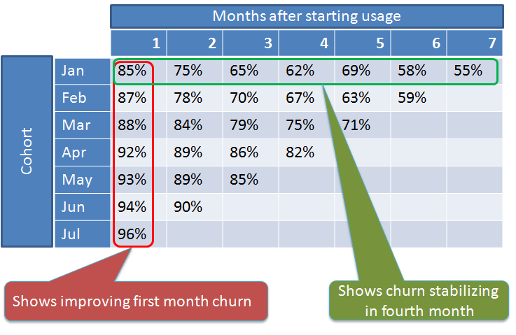
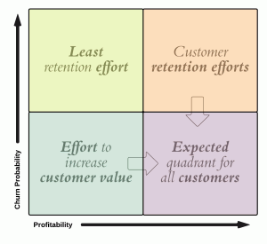
Predictive Model
Churn likelihood and profitability matrix :

Slide 24
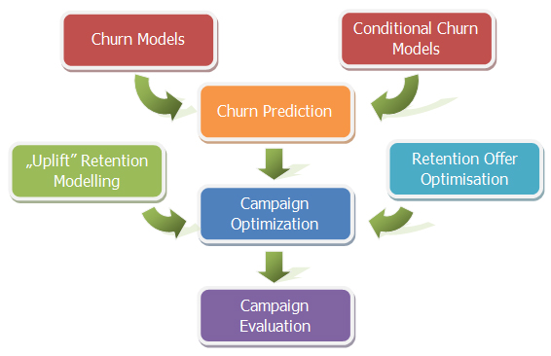
Flow of Churn Analysis

Slide 25
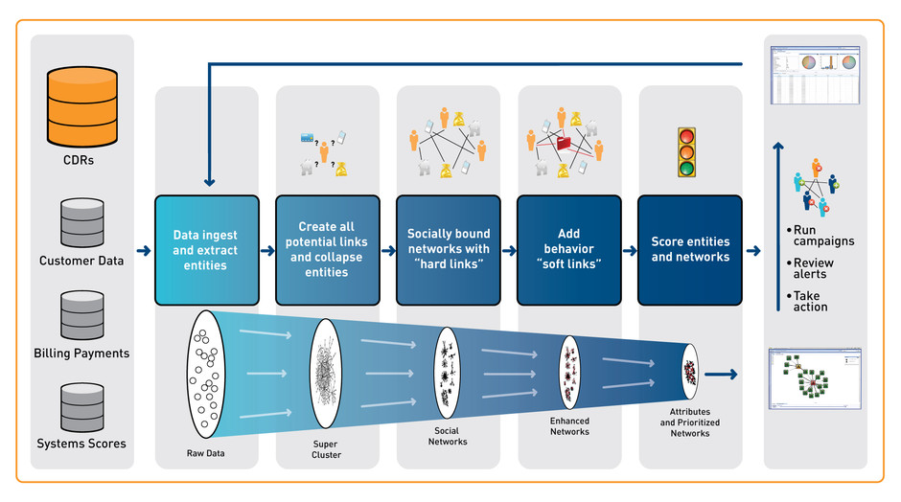
How It Goes

Slide 27
Sentiment Analysis

Slide 28
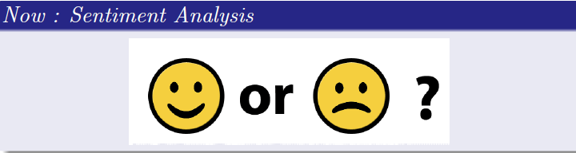
Sentiment Analysis
Generally speaking, sentiment analysis aims to determine the attitude of a speaker or a writer with respect to some topic or the overall contextual polarity of a document.
The attitude may be his or her judgment or evaluation ,affective state (that is to say, the emotional state of the author when writing), or the intended emotional.
… Wikipedia

Slide 29
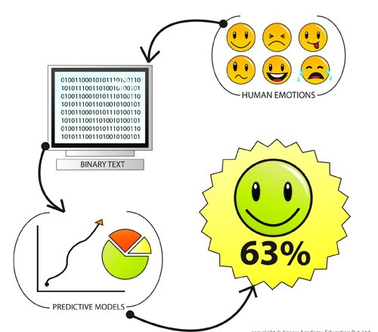
Sentiment Analysis Flow
Text Input
Tokenization
Stop word filtering
Negation handling
Classification
Sentiment class

Slide 30
Recommendation

Slide 31
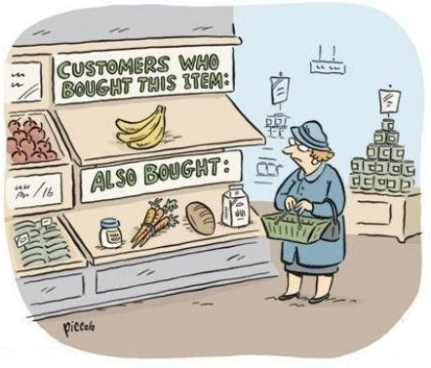


Recommendation
E-Commerce using it for recommendation!
Source: http://fortune.com/tag/predictive-analytics/

Slide 32
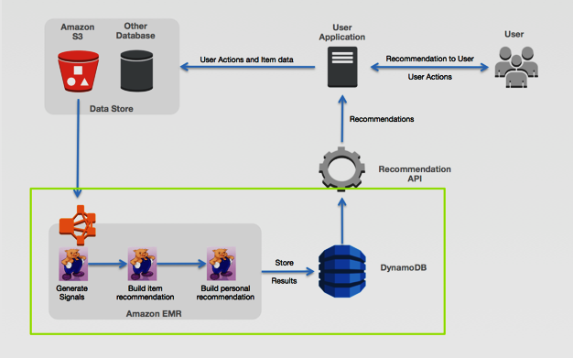
Amazon : Case Study
This is how Amazon’s recommendation engine works

Slide 34
Survey

